Slide 1
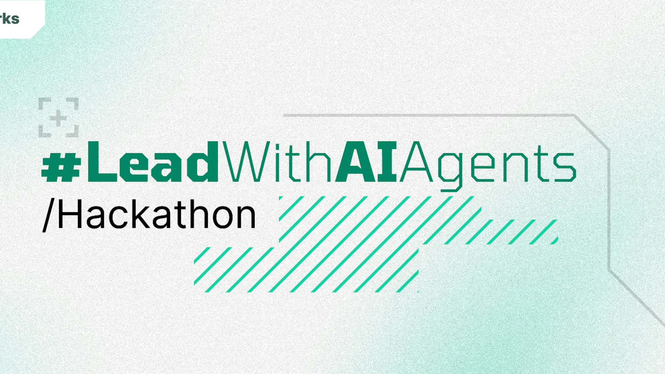
AgentGuard: Your AI-Powered Copilot for Clinical Trial Matchmaking
Rishabh Agarwal
Aditya Balakrishnan
Ritesh Kumar

Slide 2
Introducing AgentGuard: Your AI-Powered Copilot for Clinical Trial Matchmaking
AgentGuard is a multi-agent GenAI system designed to tackle one of healthcare’s most complex challenges — matching patients to clinical trials using unstructured data and simple natural language prompts.
Our Hackathon Objectives:
1
Trigger entire workflow from a single plain-text query (i.e. patient’s medical record which can be extended to API calls to any EMR system)
2
Use multiple specialized agents (Reader, Matcher, Search/ Recommender)
3
Route through a Master Agent using AgentOS orchestration
4
Solve a real-world, high-impact healthcare task

Slide 3
Need for AgentGuard
Clinical trials are broken. From slow screenings to poor retention, the traditional process is inefficient.
AgentGuard reimagines this journey using an Agentic AI workflow — delivering faster decisions, better matches, and a superior experience.
Challenges
AgentGuard
80%
Clinical data is available as text
Clinical trials fail to meet recruitment goals
Time taken to screen an oncology patient (by clinician)
Retention rate during trials
Patient awareness, fear and revolving patients
Superior
Accuracy
Highly efficient contextually relevant information extraction
Quick insights on fitment to trial & best fitting trial recommendation
Match score based on eligibility criteria and medical record
AgentGuard as Digital front door
Potential to give recommendations on Optimal Trial design
86%
Clinical
Relevance
2 hrs.
30%
Patient/Clinician
Experience
3%

Slide 4





The Guards of AgentGuard
Specialized AI Agents Working in Harmony
MatchScore Agent
Computes trial match score and rationale
Triggered: For original trial & alternates
ReadText Agent
Parses medical record, and eligibility criteria of trial
Trigger: Called first by Master Agent
Query, Medical Record, Trial ID/ Criteria
Master Agent
Powered by GenAI AgentOS
Task: Receives the prompt, routes tasks, integrates responses
Match Score, Recommended trial
Patient/ Clinical Trial Investigator/ Pharmacy
SearchTrials Agent
Finds better-matching trials by location/disease
Triggered: If initial match is weak
Tool Call: API from CT.gov

Slide 5
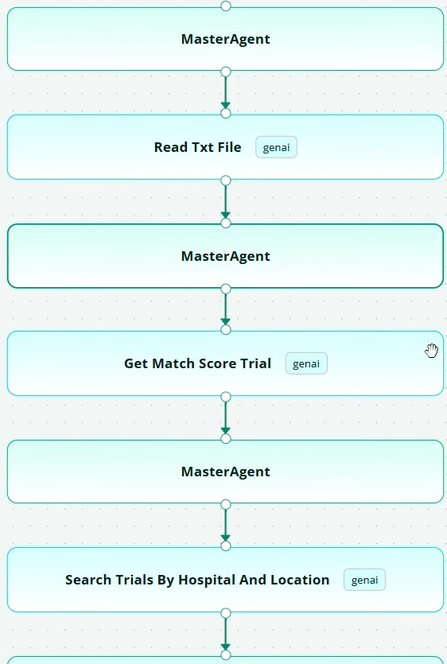
Agentic Flow
Modular, Orchestrated, and Built for Scale
🧑‍⚖️ Master Agent receives plain-text instruction
→ e.g., “Can this patient be enrolled in the clinical trial? If not, suggest alternatives.”
📄 ReadText Agent is triggered
→ Parses the attached medical record and extracts structured clinical data (age, diagnosis, vitals, etc.)
📊 MatchScore Agent is called
→ Compares extracted data to the trial’s eligibility criteria
→ Returns match score with reasons for inclusion/exclusion
❌ If the match score is low…
→ Master Agent triggers SearchTrials Agent
🏥 SearchTrials Agent
→ Finds nearby trials based on hospital/location/disease
→ Returns a list of alternate trials
🔁 MatchScore Agent is invoked again
→ Evaluates each alternate trial against the same patient data
→ Scores all alternatives
🧠 Master Agent compiles final response
→ Includes eligibility decision
→ Suggests alternate trials with match scores and explanations

Slide 6
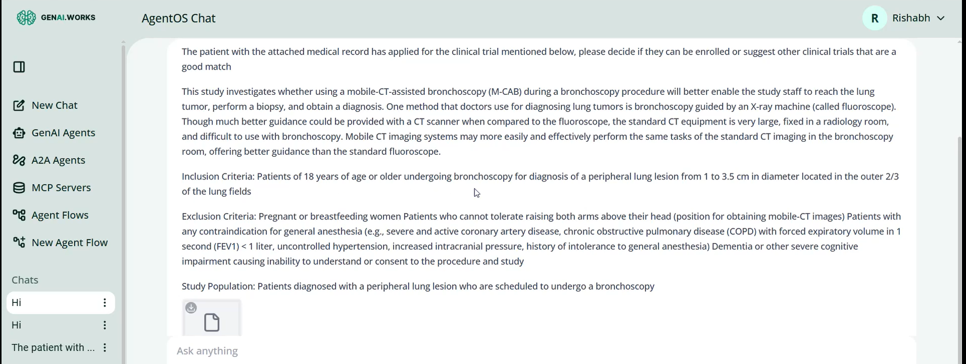
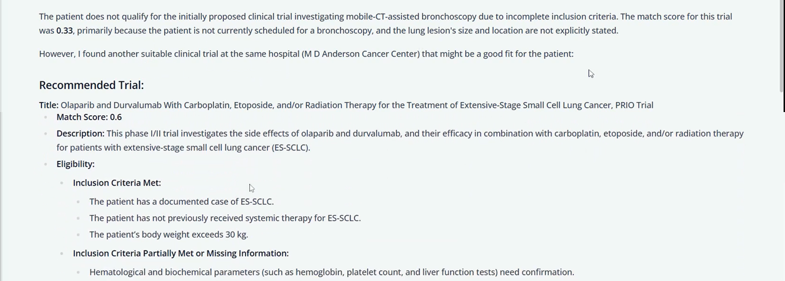
Illustration (1/2)
User Query
Agent Output

Slide 7
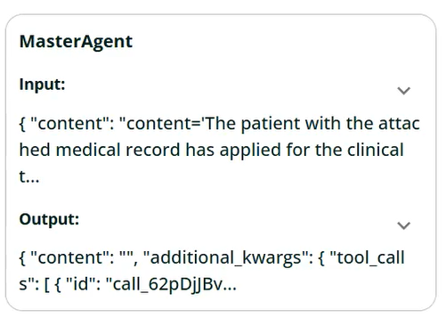
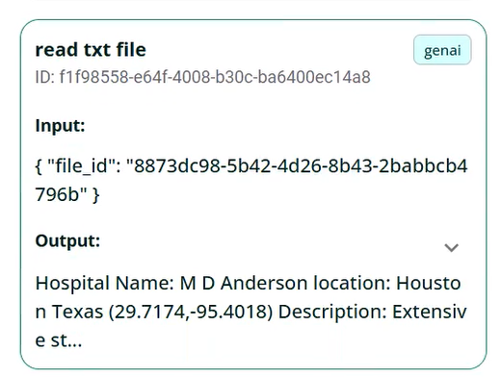
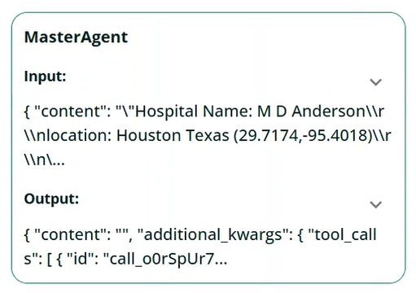
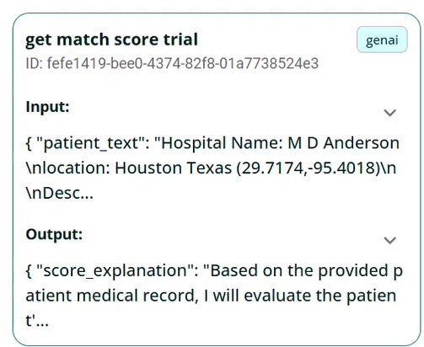
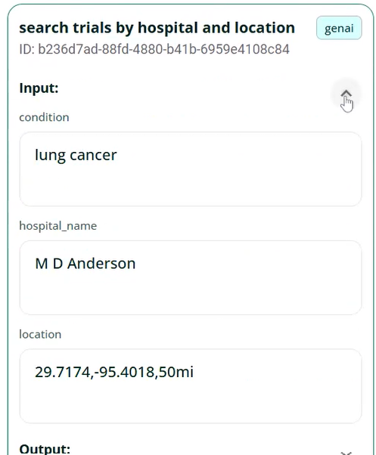
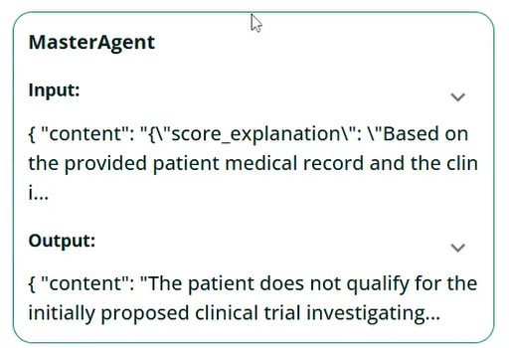
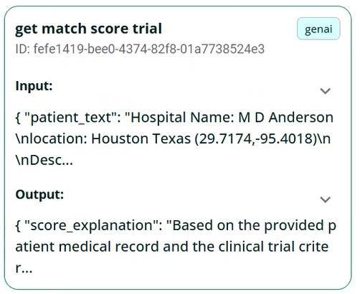
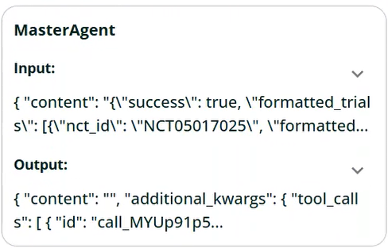
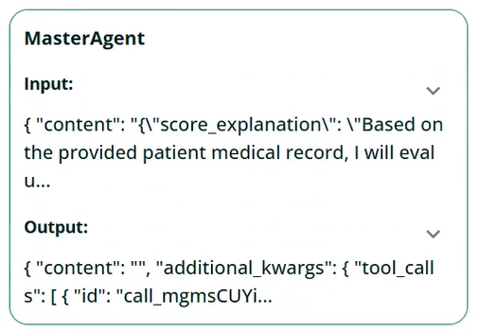
Illustration (2/2)
Agents working together to build collaborative intelligence

Slide 8
Future Scope
Multilingual Patient Support
Translate trial summaries & recommendations into regional languages
Make clinical trials more accessible to underserved populations
Expand to Other Medical Domains
Adapt agents for cardiology, neurology, rare diseases
Easily extend trial-matching logic with domain-specific ontologies
EHR & Hospital Integration
Integrate with Electronic Health Records (EHRs)
Enable auto-triggered agent workflows during patient visits
Continuous Agent Learning
Feedback loop from clinician acceptance & patient outcomes
Improve match accuracy and personalization over time
Add More Specialized Agents
Explanation Agent for patient-friendly summaries
Privacy Agent for consent-aware data sharing
Global Trial Registry Integration
Connect with WHO, NIH, and private sponsor APIs
Expand trial discovery across regions and continents

